Slide 1
Home Credit Default Risk Recognition
By
Prishika Gupta
Anu Priya
Garima Sharma

Slide 2
Business Objective
Domain Background
Many individuals struggle to obtain home loans due to poor or nonexistent credit histories, often turning to high-interest lenders.
Banks also face difficulties identifying reliable borrowers since traditional credit scores don’t provide the full picture.
Machine learning models, analyzing a broader range of factors, can more accurately assess loan default risk, benefiting both borrowers and lenders by improving loan access and reducing default risk.
Problem Statement
This study aims to build an end-to-end loan scoring system for a bank, combining application data and bureau information.
The goal is to help Home Credit decide which loan applications to approve or reject based on applicants' past behavior and application details.

Slide 3
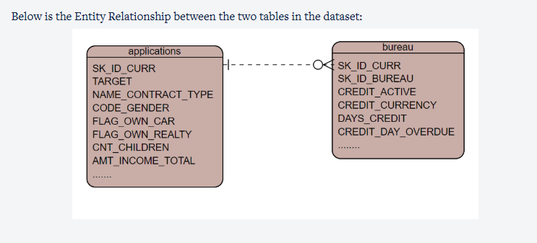
Data Understanding
There are two data sets provided for analysis:
Application data
SK_ID_CURR is the unique identifier for the applications table. Applications table consists of each individual loan applicant consisting of 122 features.
TARGET is the dependent variable for our classification problem (1 - client with payment difficulties: he/she had late payment more than X days on at least one of the first Y installments of the loan in our sample, 0 - all other cases).
Bureau data.
SK_ID_BUREAU is the unique identifier for the bureau table. Bureau table stores data at trade level and has a total of 17 features. SK_ID_CURR represents the applicant ID for which the trade is taken. The other features include credit behavior of each of the trade

Slide 4
Problem Solving Steps
Important points while building the models:
There is a class imbalance in the dataset. This needs to be handled using balanced class during each model preparation.
Select the important variables based on higher Information Value(IV) and include those features while modelling
Evaluate the accuracy of both the train and test sets and check for any overfitting
Additional validation of data should be done on the dataset on the rejected applications (performance tag null) ignored for model building.
Hyper parameters for tree models need to be optimized using GridSearch Cross validation and model with optimized parameter should be chosen.

Slide 5
Model Evaluation
Important points while building the models:
Confusion matrix for each model.
AUC-ROC curve for the model using cut-off values for each model.
Precision and Recall curve for cut-off should be generated.
Within each model type evaluation using Grid Search based on recall values should be done to get models with optimized hyper parameters.
For evaluation among models, the dataset for rejected applications (with performance tag missing), which were assumed as potentially defaulters should be considered for evaluations. Ideally, the output for all these applications should be defaulters.

Slide 6
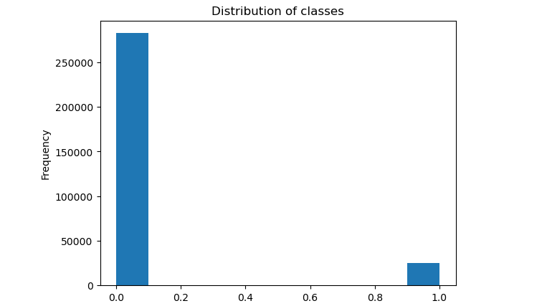
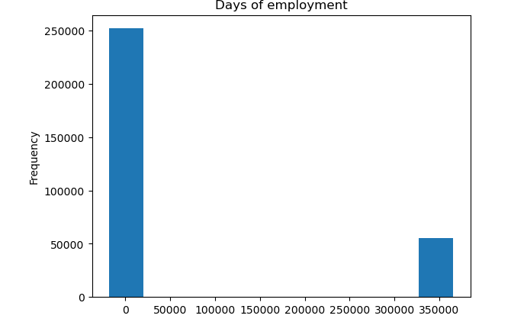
EDA
There is a huge difference between the instances of 0 and 1
We notice the huge difference between the classes of employment days.

Slide 7
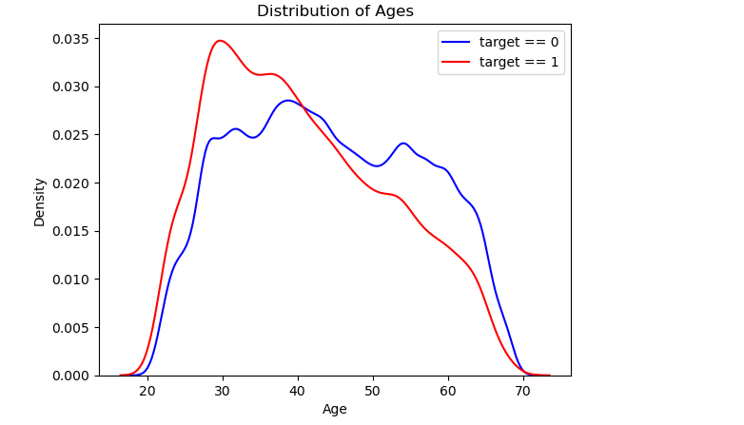
EDA
The age feature was also recorded in negatives and in days
We notice the huge difference between the classes of employment days.

Slide 8
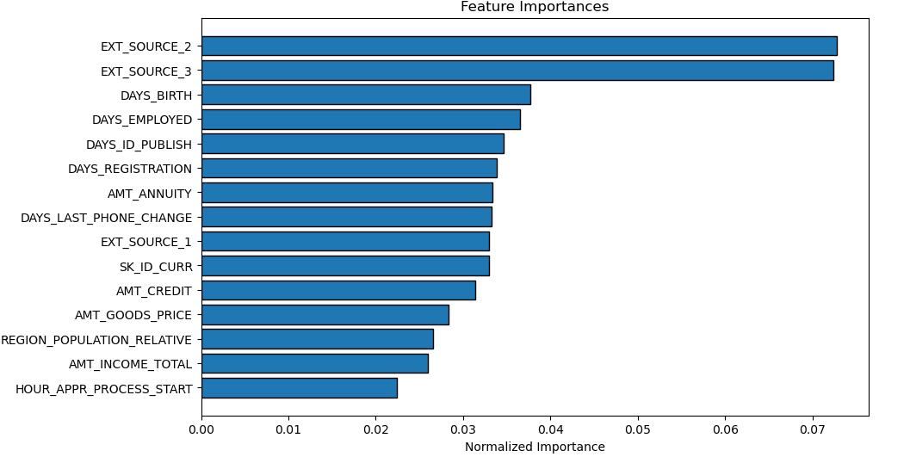
EDA
According to random forest's feature importances, the external source 3 and 2 are the two most important ones.

Slide 9
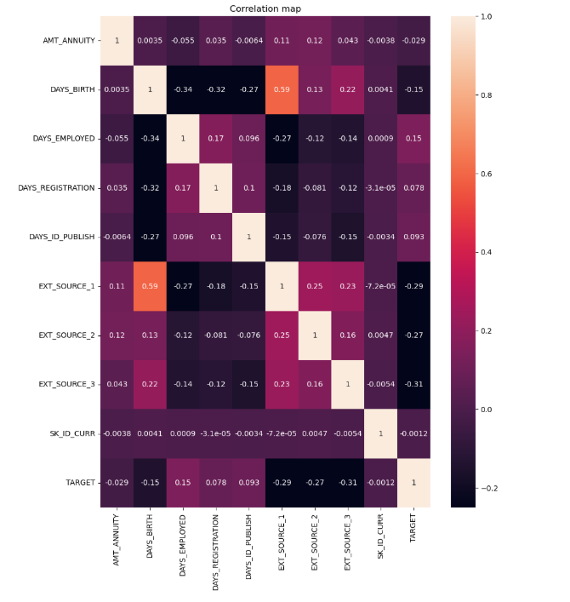
EDA
Key observations :
Strongest positive correlations:
DAYS_BIRTH and EXT_SOURCE_1 (0.59) - This suggests that older people tend to have higher EXT_SOURCE_1 scores (whatever that metric represents).
Strongest negative correlations:
DAYS_BIRTH and DAYS_EMPLOYED (-0.34) - This is expected as older people are likely to have been employed for longer.
EXT_SOURCE_1 and TARGET (-0.29) - A higher EXT_SOURCE_1 score seems to be associated with a lower likelihood of the TARGET event (likely loan default).
EXT_SOURCE_3 and TARGET (-0.31) - Similar to EXT_SOURCE_1, a higher EXT_SOURCE_3 score appears to indicate a lower risk of default.
Weak correlations: Many variables show weak correlations (close to 0), indicating little to no linear relationship.

Slide 10
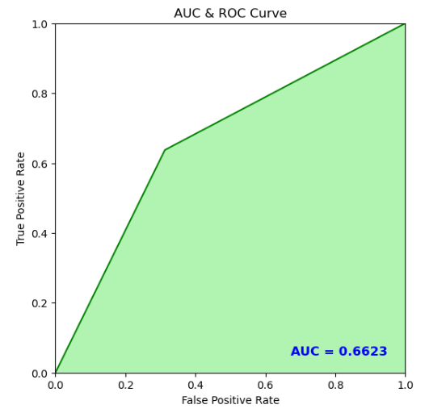
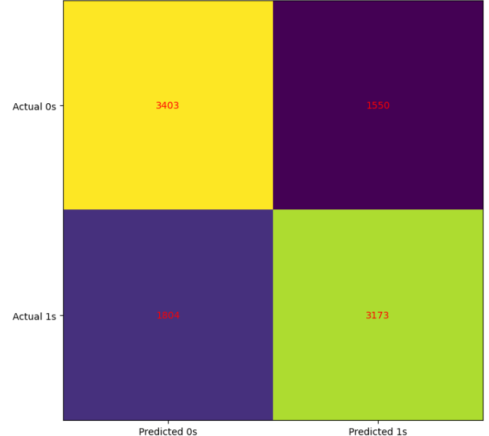
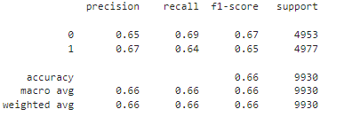
Logistic Regression
The Auc Roc curve shows that the model's classification ability is minimum.
The confusion matrix gives us an idea of the distribution of True positives/negatives and False positives/negatives.
The model's accuracy is about 0,66 which mean out of all the instances predicted, 66% were correctly predicted.
Precision is 0,65 for class 0, which means that out of all the instances for which the model predicted 0, 65% of them were actually 0.
Recall is 0.69 for class 0, which means that out of all the instances that have a target of 0, 69% were predicted correctly by our model.

Slide 11
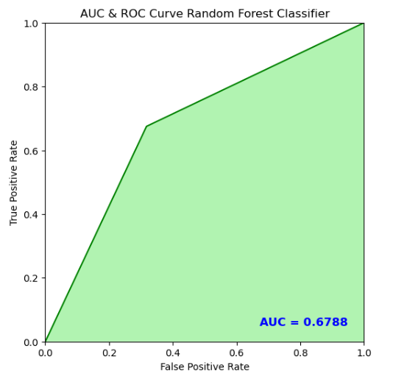
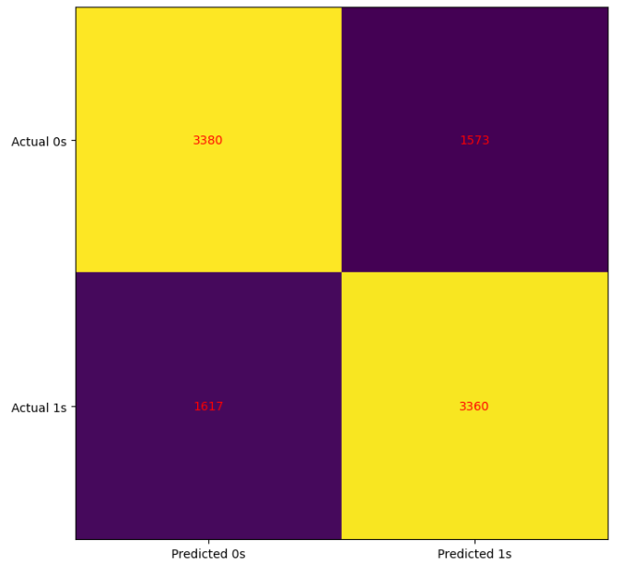
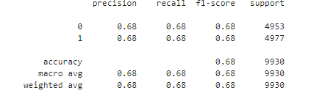
Random Forest Classifier
The Auc Roc curve shows that the model's classification ability is slightly better that that of Logistic regression.
The confusion matrix gives us an idea of the distribution of True positives/negatives and False positives/negatives, and we see that the false positives are less than the previous model.
The model's accuracy is about 0,68 which mean out of all the instances predicted, 68% were correctly predicted.
Precision is 0,68 for class 0, which means that out of all the instances for which the model predicted 0, 68% of them were actually 0.
Recall is 0.68 for class 0, which means that out of all the instances that actually have a target of 0,68% were predicted correctly by our model.

